Slide 1
Complete the sentence with the right form of the verbs
1. If I see him, I……………..a gift.(give)
2. I……………myself if I had a type writer.( type)
3. You could make better progress if you……………. Class regularly.( attend)
4. If I ……………….his phone number, I’d give it to you.( know)
5. If he worked a little bit more slowly, he…………………..mistakes( not/make).
6. If today…………………Sundays, We…………….. to school. (not/ go)
7. If ………………., we will go on a picnic.( not/ rain).
8. If you…………………lazy, you won’t fail the exam.( not/be)
9. David could come to my party today if he……………… to work.(not/ go)
10. If She……………..here, she could answer all the questions.( be)
11. If he………… (study), he will pass the exams easily.
12. If the sun shines, we ………………..(walk) into town.
13. If he ……………….(have) a temperature, he sees the doctor.
14. If my friends came, I………………… (be) very happy.
15. If she…………… (earn) a lot of money, she will fly to New York.

Slide 2
16. If we ………….(travel) to Hanoi, we would visit the museums.
17. If you wear sandals in the mountains, you…………. (slip) on the rocks.
18. If Giang ……(forget) her homework, the teacher’ll give her a low mark.
19. If they…. (go) to the disco, they’ll listen to loud music.
20. If you wait a minute, I ……………(ask) my parents.
21. If we meet at 9:30, we…………….. (have) plenty of time.
22. Lisa …………… the milk if she looked in the fridge.
If you spoke louder, your classmates……………. (understand) you.
24. Dan………… (arrive) safe if he drove slowly.
25. The door …………( not/lock) if you press the green button.
I would call the office if I…………. (be) you.
27. The soil………………… (not/dry out) if you water the plants regularly.
28. If you ……….(not/ give) the young boy this stick, he wouldn’t hurt himself.
29. If the cat hides in the tree, the dog…………………. (not/find) it.
30. Linda………. (read) the newspaper if she went by train.

Slide 3
Rewrite the sentences that mean the same the printed before.
1. Keep silent or you’ll wake the baby.
If ………………………………………………………………………..
2. Stop talking or you won’t understand.
If ………………………………………………………………………..
3. I don’t know her phone number so I can’t phone her.
If ………………………………………………………………………..
4. Peter is fat because he eats so many candies.
If ………………………………………………………………………..
5. Peter and Susan argue a lot so they aren’t happy.
If ………………………………………………………………………..
6. Give me the money or I’ll kill you.
If ………………………………………………………………………..
7. George doesn’t do his homework regularly so can’t keep up with other students
If ……………………………………………………………………………………
8. Hurry up or we’ll be late.

Slide 4
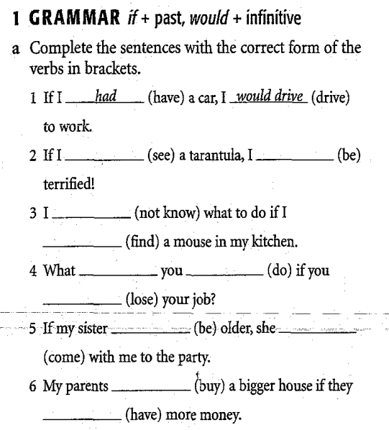
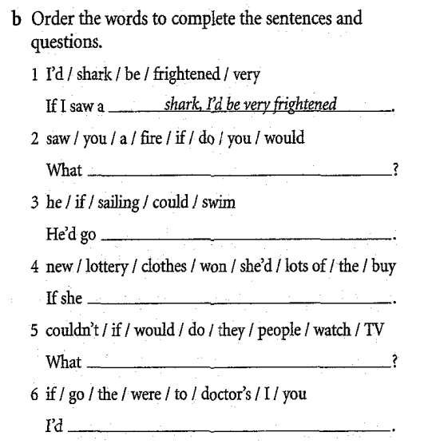

Slide 5
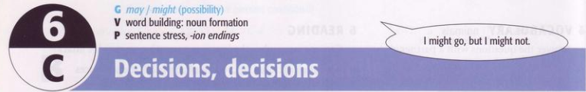
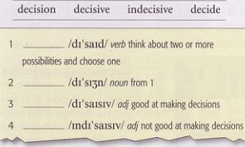
a. Complete the definitions with words from the box. Underline the stressed syllable
decide
decision
decisive
indecisive

Slide 6
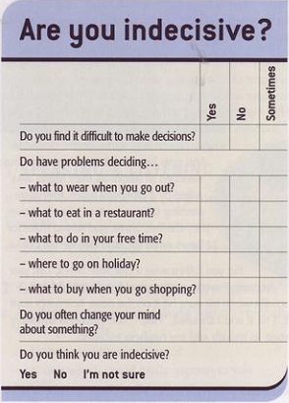
b. Interview your partner with the questionnaire. Ask for more information. Which of you is more indecisive?

Slide 7
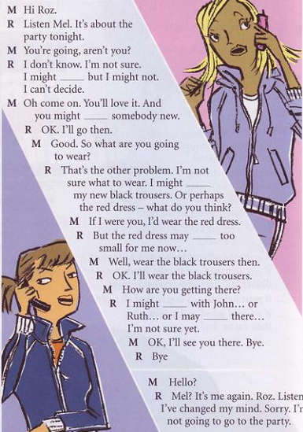

a. Cover the dialogue and listen. Who’s indecisive. Roz or Mel? What about?
go
meet
wear
Roz is indecisive about going to the party, what clothes to wear, and how to get there.
be
go
walk
b. Listen again and complete the conversation

Slide 8
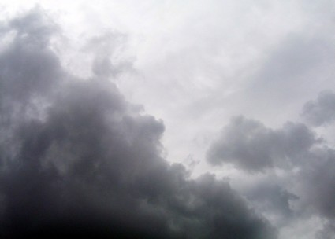
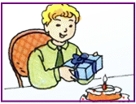


Modals: May and Might
1. Examples:
It might rain tonight.
or It may rain tonight
It may be a book
or it might be a game.
You may park here.
You may not smoke here.

Slide 9
2.Forms:
S + may /might (not) + V
3.Uses:
We use may/ might to say that something is possible at present or in the future. However, might is less possible than may.
We use may to say that something we have permission to do. We do not use might in this case.
Ex: May I use your phone? (= can I use your phone)

Slide 10
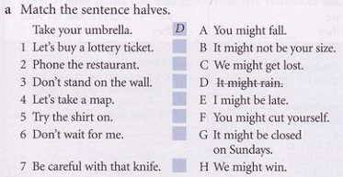
H
G
A
C
B
E
F

Slide 11
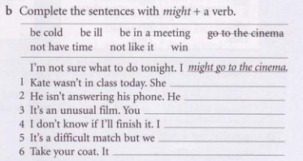
might be ill
might be in a meeting
might not like it
might not have time
might win
might be cold

Slide 12
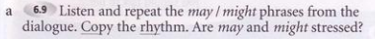
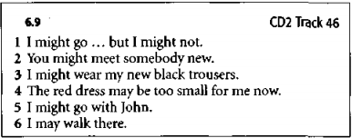
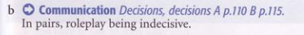
may and might are stressed

Slide 13
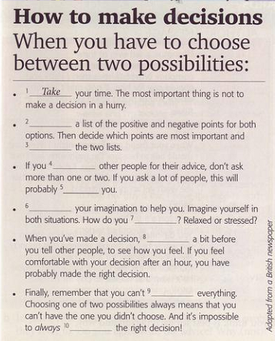
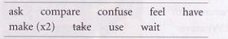
Complete the text with these verbs from the box
Make
compare
ask
confuse
Use
feel
wait
have
make

Slide 14
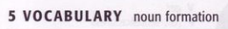
With some verbs you can make a noun by adding -ion, -sion, or -ation
e.g. decide - decision
imagine - imagination
act - action

Slide 15
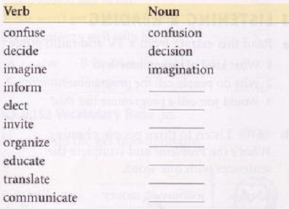
Complete the chart.
information
election
invitation
organization
education
translation
communication
Listen and check. Underline the stressed syllable in the verbs and nouns.
How do you pronounce -sion and -tion?
Where is the stress in nouns which finish in -ion?
The stress is always on the syllable before this ending
/∫ən/ or /ʒən/

Slide 16
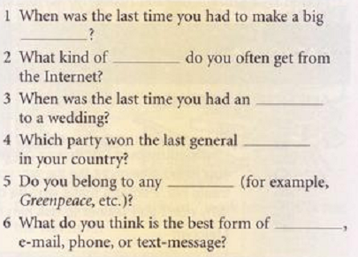
Complete the questions with a noun from a
decision
information
invitation
election
organization
communication

Slide 17
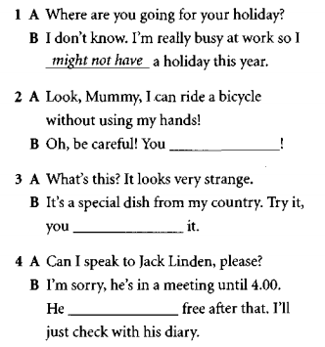
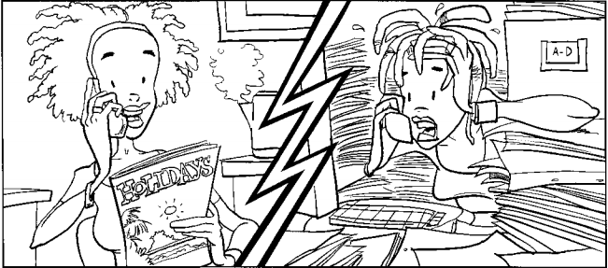
Excercises:

Slide 18
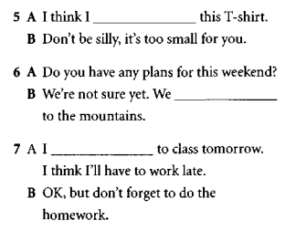
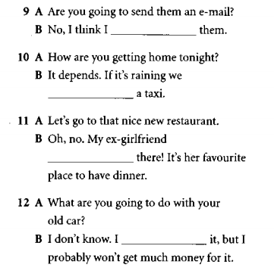
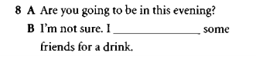

Slide 19
Find the mistake in each of the following sentence and correct it.
1. Zara can make a new line of clothes in three week.
2. The clothes also change to week to week so customers keep coming back to see what’s new.
3. She always get dressed before she has breakfast in the morning.
4. What dress did you worn to go to the party?
5. I always try off clothes in a shop before I buy them.
6. I’m colds. I’m going to wear a sweater.
7. It’s very hot here. Take on your coat.
8. I’ve read the book but I haven’t saw the film.
9. Tim have not been to a Japanese restaurant.
10. I have been to this bar lot of times.
11. Daniel has give his girlfriend some flowers on her birthday.

Slide 20
Use the given words to complete sentences
1. He/the/ tall/student/ the/ class
2. He/not/read/ the/ newspaper/ today
3. They/ be/most/ beautiful/girls/ I/ ever/ see
4. She/ always/ get/dress/before/ have/ breakfast/ the morning
5. It /cold/ here/, put/ your/sweater
6. She/ just break/ her leg
7. They/eat/there/before?
8. David/ brother/ have/ an argument/ his/ wife
9. Your/ mother/fly/ before?
10. How/ you/ go/ to / wedding/ last/summer?

Slide 21
Read the passage and circle the best word (A, B, or C) for each space.
An American banker was walking on a beautiful beach in a small Mexican village. He (1)_____ a fisherman in his boat with a few fish on it.
“Great fish” he said. “How long did it take you (2)_____ them?”
“Not very long”, answered the fisherman.
“Why didn’t you (3)_____ at sea longer to catch some more?” asked the banker.
“There are just enough fish here to feed my family,” answered the Mexican.
Then the American asked, “But what do you do the rest of the time?”
“I (4)_____ late, I fish a little, I play with my kids, I have siestas. In the evening, I go to see my friends in the village. We drink wine and play the guitar. I'm (5)_____than you think. Life here isn’t as…”
1. A. saw B. sees C. seen
2. A. catch B. to catch C. to catching
3. A. stay B. stayed C. staied
4. A. slept B. sleeped C. sleep
5. A. busy B. busyer C. busier

Slide 22
Read the passage and circle the best word (A, B, or C) for each space.
Hi Alessandra!
Thanks for your last email, I hope your exams went well. I have some exciting news and I’m writing (1)_______ for your advice.
I want (2)_______ go on holiday to Argentina next year. What do you think is the (3)______ month for me to come? I can only come for three weeks, so which places do you think I should (4)_______ a car or travel around by bus or train?
I’m planning to spend a few days in and around Mendoza, and it would be great if we could meet. Can you recommend a good hotel (not too expensive)?
Hope (5)______ from you soon!
Best wishes,
Daniel
1. A. to ask B. for ask C. asking
2. A. for B. to C. in
3. A. good B. gooder C. best
4. A. hire B. to hire C. hires
5. A. to hear B. hearing C. hear

